Slide 1
MO SW-PBS Advanced Tiers
Course 2 Systems to Identify Students in Need of Advanced Tier Support

Slide 2
Facilitator Notes: Delete This Slide
Plan Attention Signal
Plan Introductions/ Activity
Handouts needed
Criteria Measures Example and Template
EXAMPLE Advanced Tiers Teacher Nomination Form
Universal Screening Instruments
Universal Screening Considerations
Evaluating Universal Screeners

Slide 3
Working Agreements
Be Respectful
Be an active listener—open to new ideas
Use notes for side bar conversations
Be Responsible
Be on time for sessions
Silence cell phones—reply appropriately
Be a Problem Solver
Follow the decision-making process
Work toward consensus and support decisions of the group
Notes:
“These will be the Working Agreements we will honor during all our training sessions this year.”

Slide 4
Attention Signal
Notes:
Trainer Notes: Facilitator: Select an attention signal.
“One of our agreements is to follow the attention signal.”
“Your team will work with your school to develop an attention signal you will use in every setting.”
“In order to get all of you focused after discussions, activities or breaks,
I will ________________________________________.”
(Insert your attention signal here.)
“Your task will be to finish your sentence, quiet your voice and ____________________________.”
(Insert what you want participants to do.)

Slide 5
Introductions
Notes:
Trainer Notes: Facilitator: Select an introductions activity

Slide 6
Handouts
Student Identification Process Guide
Example Criteria Measures
Template Criteria Measures
Example Advanced Tiers Teacher Nomination Form
Universal Screening Instruments (At-a-Glance)
Evaluating Universal Screeners
Universal Screening Considerations
Notes:
There are several handouts associated with this lesson

Slide 7
Lesson Description
This lesson guides Advanced Tiers Teams through creating
systems to identify students who may need additional support
using these three systems:
review existing school data
nomination process
universal screening process.
Notes:
Today we are focusing on building systems to identify students who may need additional support

Slide 8
Lesson Outcomes
At the end of this session, you will be able to…
Create a system to…
  Review existing school data
  Utilize a nomination process
  Utilize a universal screening process
In order to identify students who may need additional support.
Notes:
Again, the main outcome today its to create your system to Identify students who may need additional support!

Slide 9
Rationale
The Student Identification Process assists teams with early
identification of students whose behaviors are:
  impacting their ability to learn
  are unresponsive to universal practices
Notes:
Here are a few more points as to why having a system for identifying student who may need support is important.
Early identification and intervention can decrease the likelihood of academic failure
No, it is not necessary to exhaust all possible identification methods. However no single method is likely to identify all students who may need additional support. It is recommended that schools use multiple strategies.
An effective student identification system should provide information on students experiencing internalizing and externalizing behaviors

Slide 10
Reflective Questions
To what degree are the 8 Effective Teaching and Learning practices being implemented school-wide?
How do we provide support to teachers to implement these strategies at an intensified level?
How do we support new teachers and new – to- district teachers during their first year?
Notes:
Trainer Notes: Have a strategies for participants to group/partner up and discuss Tier 1 implementation.
Based on the graphic of the Triangle we know that advance tier supports build upon Tier 1 supports. In order to have effective and sustainable implementation at advanced tiers, Tier 1 supports must also be implemented with fidelity and implemented with sustainability. Take a few moments to discuss the current reality of implementation at the Tier 1 level.

Slide 11
Pre-Requisites
Tier 1 Courses:
Foundations: Science of Behavior
Tier 1 Essential Components
Tier 1 ETLPs
Advance Tier Courses:
Course 1 Teaming
Notes:
For this course to be the most effective these previous modules need to be completed and implemented before the completion of this module!
If you have not completed the previous lessons in this course, please complete them before moving forward!

Slide 12
Missouri Teacher Standards Addressed
2.1: Cognitive, social, emotional and physical development
2.6: Language, culture, family and knowledge of community
3.1: Implementation of curriculum standards
5.1: Classroom management, motivation and engagement
5.2: Managing time, space, transitions and activities
5.3: Classroom, school and community culture
6.1: Verbal and nonverbal communication
6.2: Sensitivity to culture, gender, intellectual and physical differences
8.1: Self-assessment and improvement
8.2: Professional learning
Notes:
These are the Missouri Teacher Standards that will be addressed in this lesson. If you want more information regarding these standards visit DESE.MO.GOV

Slide 13
Key Terms
Internalizing Behavior
Externalizing Behavior
Criteria Measures
Notes:
ere are a few Key terms that will be used throughout this lesson!

Slide 14
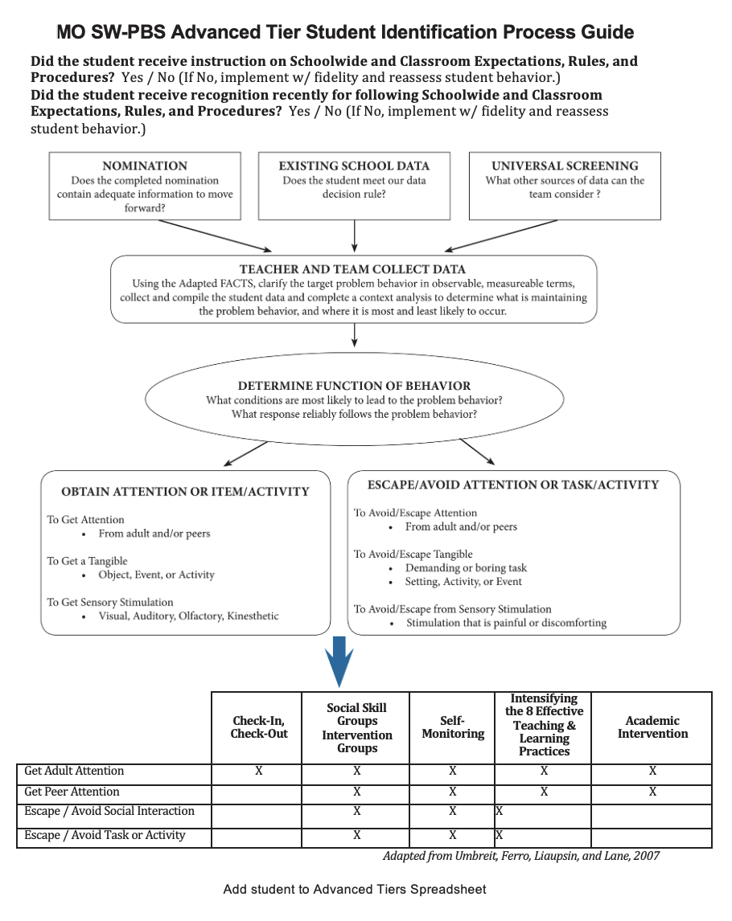

Options for Systematic and Early Student Identification:
Existing School Data
& either
Nomination
or
Existing School Data
Notes:
Trainer Notes: This slide is animated
One of the first tasks of the Advanced Tiers Team is to establish a system to identify students who may require and benefit from Tier 2 or 3 intervention.
Access the “Advanced Tiers Student Identification Process Guide” handout and follow along.
We will take a look at three different methods for identifying those students:
<CLICK > Review of Existing School Data,
<CLICK > & either Nomination Process, or…
<CLICK > Universal Screening.
Advanced Tier teams are all encouraged to leverage the existing school data they are already collecting and then choose at least one additional “pathways” to ensure that they answer two important questions:
Is our system allowing for early intervention? and
is our system Identifying both students with externalizing behaviors and students with internalizing behaviors?
While your team will learn more about matching the function of student behaviors to interventions in the next course, we have included all information on a single handout to serve as a helpful one-stop guide.

Slide 15
Existing School Data
Notes:
One way to find at-risk students is through Existing School Data.
Student data that is already being collected within your building. Specifically, teams set criteria that when “triggered” automatically initiates discussion about a student who may be at risk. After reviewing student data, the Advanced Tiers team can then determine if intervention is warranted.

Slide 16
Externalizing Behavior: Behavior problems that
are observable and overt, often directed toward
people and/or objects in the social environment.
Internalizing Behavior: Behavior problems that
the students directs inwardly toward him or herself.
Notes:
Trainer Notes: This slide is animated
The process for identifying students as at-risk or high-risk should catch students with externalizing behaviors as well as students with internalizing behaviors.
<CLICK> Externalizing behaviors are behavior problems that are observable and overt, often directed toward people and/or objects in the social environment (Walker and Severson, 1991). Behavior problems in the externalizing dimension are exhibited at high rates and/or intensity and are considered inappropriate in school settings. behaviors include, but are not limited to: talking out, non-compliance, out of seat, disturbing others, talking back, and rude comments to peers, along with more serious behavior such as aggression toward people, destruction of property, theft, and serious violation of rules (Walker, Colvin, & Ramsey, 2004).
<CLICK> Internalizing behaviors are behavior problems that the student directs inwardly toward himself or herself. Internalizing behaviors are often based on social deficits and avoidance (Walker and Severson, 1991). Examples of internalizing behaviors include, but are not limited to, (a) exhibiting shy, timid, or nonassertive behavior; (b) avoiding or withdrawing from social situations (e.g., not talking with peers; not participating in activities or games); and (c) non-responsiveness to social overtures from others (Walker, Colvin, Ramsey, 2004).

Slide 17

Review of Existing School Data
Office discipline referrals
Classroom minor events
Attendance
Academic performance
Grades etc.
Notes:
Criteria Measures are automatic triggers that start conversations about a student who may be at risk..
Criteria Measures tend to find students with externalizing types of behaviors.
To establish Criteria Measures using existing school data, teams must first consider and document student data that already is routinely collected.
Office discipline referrals (ODRs) and/or classroom minor behavioral records, attendance and tardy rates, classroom assignment and/or homework completion rates and grades, formative assessment results, and nurse or counselor visits are common types of data most schools collect and can easily access to use for decision making.
In a setting with few to no ODR’s, such as Early Childhood or Alternative schools, using existing school data may not be as relevant as a nomination form or universal screening.

Slide 18
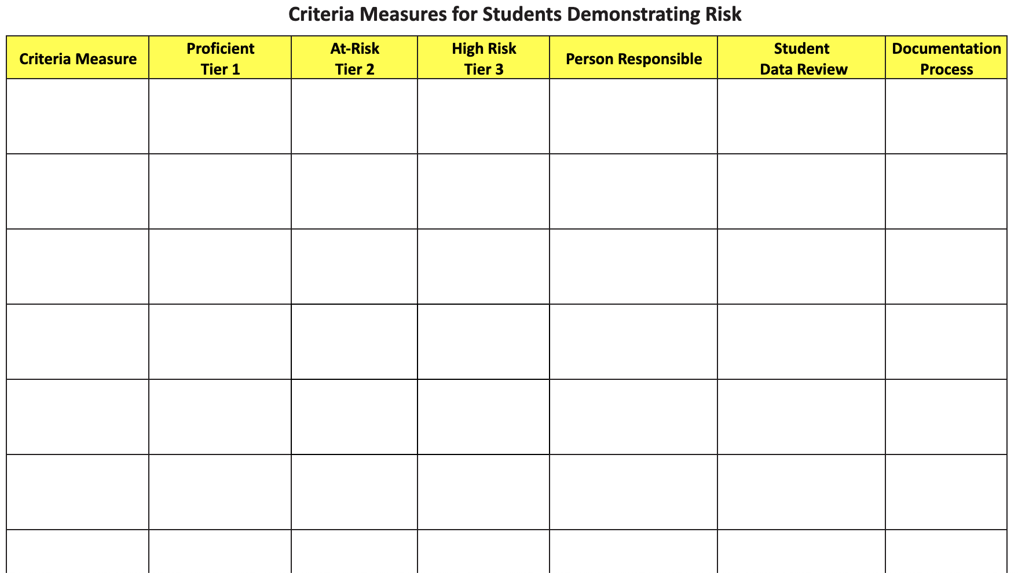
Criteria Measures for Students Demonstrating Risk
How do you differentiate whether the student needs a Tier 2 intervention vs Tier 3?
At Risk vs High Risk
Notes:
Your Advanced Tiers team will need a system that answers the question - How do we differentiate whether the student needs a tier 2 intervention vs tier 3?
One way to think of risk criteria is as a spectrum that includes low/no risk, at-risk, and high risk.
The low/no risk criteria would identify most students who would reasonably be expected to function for that given data source; it is important to include reasonable opportunities for error when determining this risk threshold.
The at-risk criteria would identify areas of functioning that could indicate a student is at-risk for future failure. When determining at-risk criteria, it is important to consider these as potential warning signs.
The high risk criteria would identify areas of functioning that indicate a student is experiencing high rates of failure. (High risk criteria will be beneficial in determining students who might benefit from accessing Tier 3, individualized support)

Slide 19
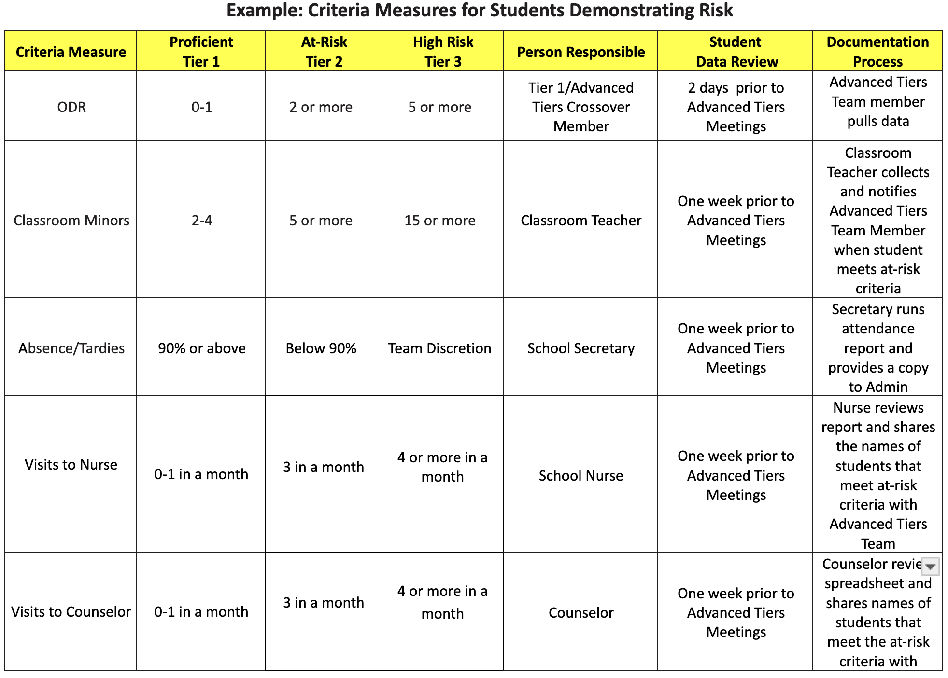
Criteria Measures Example and Template
Notes:
Once existing data sources have been identified, school teams need to determine risk criteria for each of these data sources.
Now the team will determine what constitutes at-risk and high-risk for all the data your team Identified.
(EX. During the data cycle has the student met the at-risk criteria to be considered for Tier 2 (3 ODR) or were the behaviors so chronic/frequent that they met the criteria for Tier 3 ( 5 ODR))

Slide 20

Chronic Problem Behavior
“Persistent, unlikely to be temporary” –which could be a regular pattern
over a few months
(K. McIntosh, personal communication, Aug. 5, 2011)
“ . . . repeated or re-occurring over a period time, the behavior has
persisted for a while“
(Goodman, 2011)
Notes:
Research by the University of Oregon PBIS Workgroup suggests that students at risk of developing chronic behavioral problems might not receive adequate support soon enough to change their behavioral trajectories.
Students exhibiting these behaviors may be referred directly to Tier 3 but will most likely have participated in a Tier 2 intervention unsuccessfully. And these chronic behaviors are impeding their ability to make academic progress.
So, who would be considered to have chronic misbehavior that you wouldn't catch through Tier 2 intervention first? You may consider students who move in with a history of chronic behaviors.

Slide 21
Pause & Reflect – Existing School Data
What data do you currently review?
How do you currently use Existing School Data to identify students for additional support?
Who monitors the data?
How quickly are decisions made about intervention?
Are there additional criteria measures you may want to include to ensure early identification of all students who may be at-risk?
How might you document the data criteria?
Who will ensure those students who reach the “at risk” number are brought to the Advanced Tier team for discussions?
Notes:
Take a moment to reflect with your team.
Use the Criteria Measures Template to document data that is currently being collected or will be collected.
During this reflection time, use these prompts as guiding questions to develop your criteria measures for each set of data to identify students who may benefit from Tier 2 and or Tier 3 interventions!
With your team, review the office-managed (major) referral data from your most recent school year. Based upon this data, determine what criteria your school should establish for low/no risk, at-risk, and high risk from this data source.
With your team, review the risk criteria that had previously been established and determine what decision rules your school will utilize when identifying students who should be considered for inclusion in an intervention.
Do your identified decision rules support early identification of students who may be at-risk?
Repeat this step for all data that is being collected and monitored for Identifying students who may benefit Advanced tier interventions.

Slide 22
Teacher Nomination
Notes:
The Teacher Nomination for Assistance should be short and simple and designed for quick response. Most of the schools have some type of nomination or referral process in place. However, for a variety of reasons teachers are more likely to refer students for academic concerns than for behavior. In addition, students who are nominated for behavior tend to exhibit externalizing behaviors.

Slide 23
A Nomination Process
To ensure early identification
Inclusive of students who exhibit internalizing behaviors
Provides an avenue for all relevant stakeholders (ex.staff, parents, etc.) to voice concerns to the Advanced Tiers Team
Notes:
Review of existing data will aid teams in identifying students who exhibit externalizing behaviors that impede their academic progress. However, relying solely on existing data to identify students could allow students who demonstrate internalizing behaviors to slip through the cracks. This is why it is recommended that teams consider adopting at least 2 methods for identifying students at-risk. An effective identification system which includes a process that allows teachers, parents, and/or students to submit candidate names to be considered for advanced tiers support.
Establishing a nomination process will increase the likelihood of identifying students who demonstrate externalizing and internalizing behaviors.

Slide 24

Nomination Process –
Considerations
Notes:
An effective identification system will include a process that allows teachers, parents and/or students themselves to submit candidate names to be considered for Advanced Tier supports and that promotes early intervention.
The following considerations will help teams as they make decisions to develop a nomination process or to revise an existing procedure.
A staff nomination process is scheduled at designated points across the school year (e.g., near the end of the first-grade reporting period) during which teachers are provided with a description of risk characteristics and asked to review a list of students in their class.
Names of students who meet risk criteria are submitted. Teachers should also be trained to consider students who are exhibiting internalizing behaviors.
Nominations should also be allowed by teachers, students and family at any time there is a concern noted.
Most importantly nominations should be designed for quick response including supports for classroom teacher and/or rapid access to intervention for student being available within a brief period of time.

Slide 25
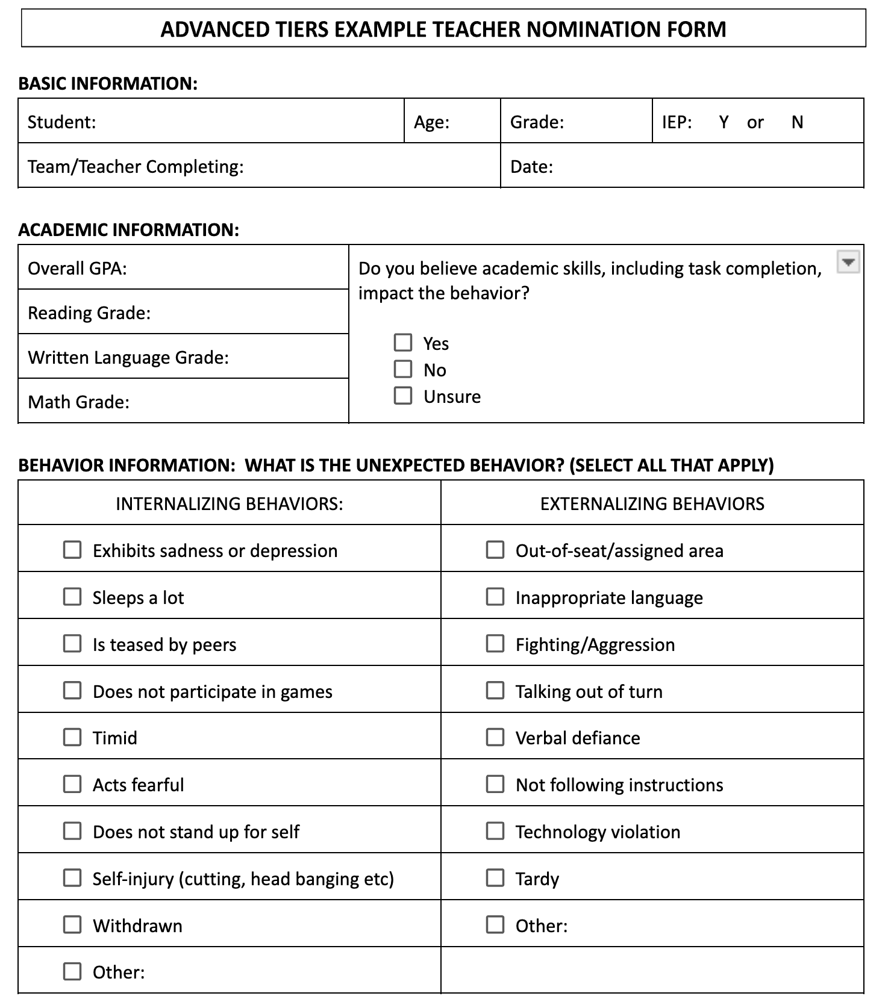
Sample Advanced Tiers Teacher Nomination Form
Notes:
Here is a sample form You will note it is very simple with only 4 areas.
The three sections displayed on this slide include:
Basic Information
Academic Information
Unexpected Behavior descriptors

Slide 26
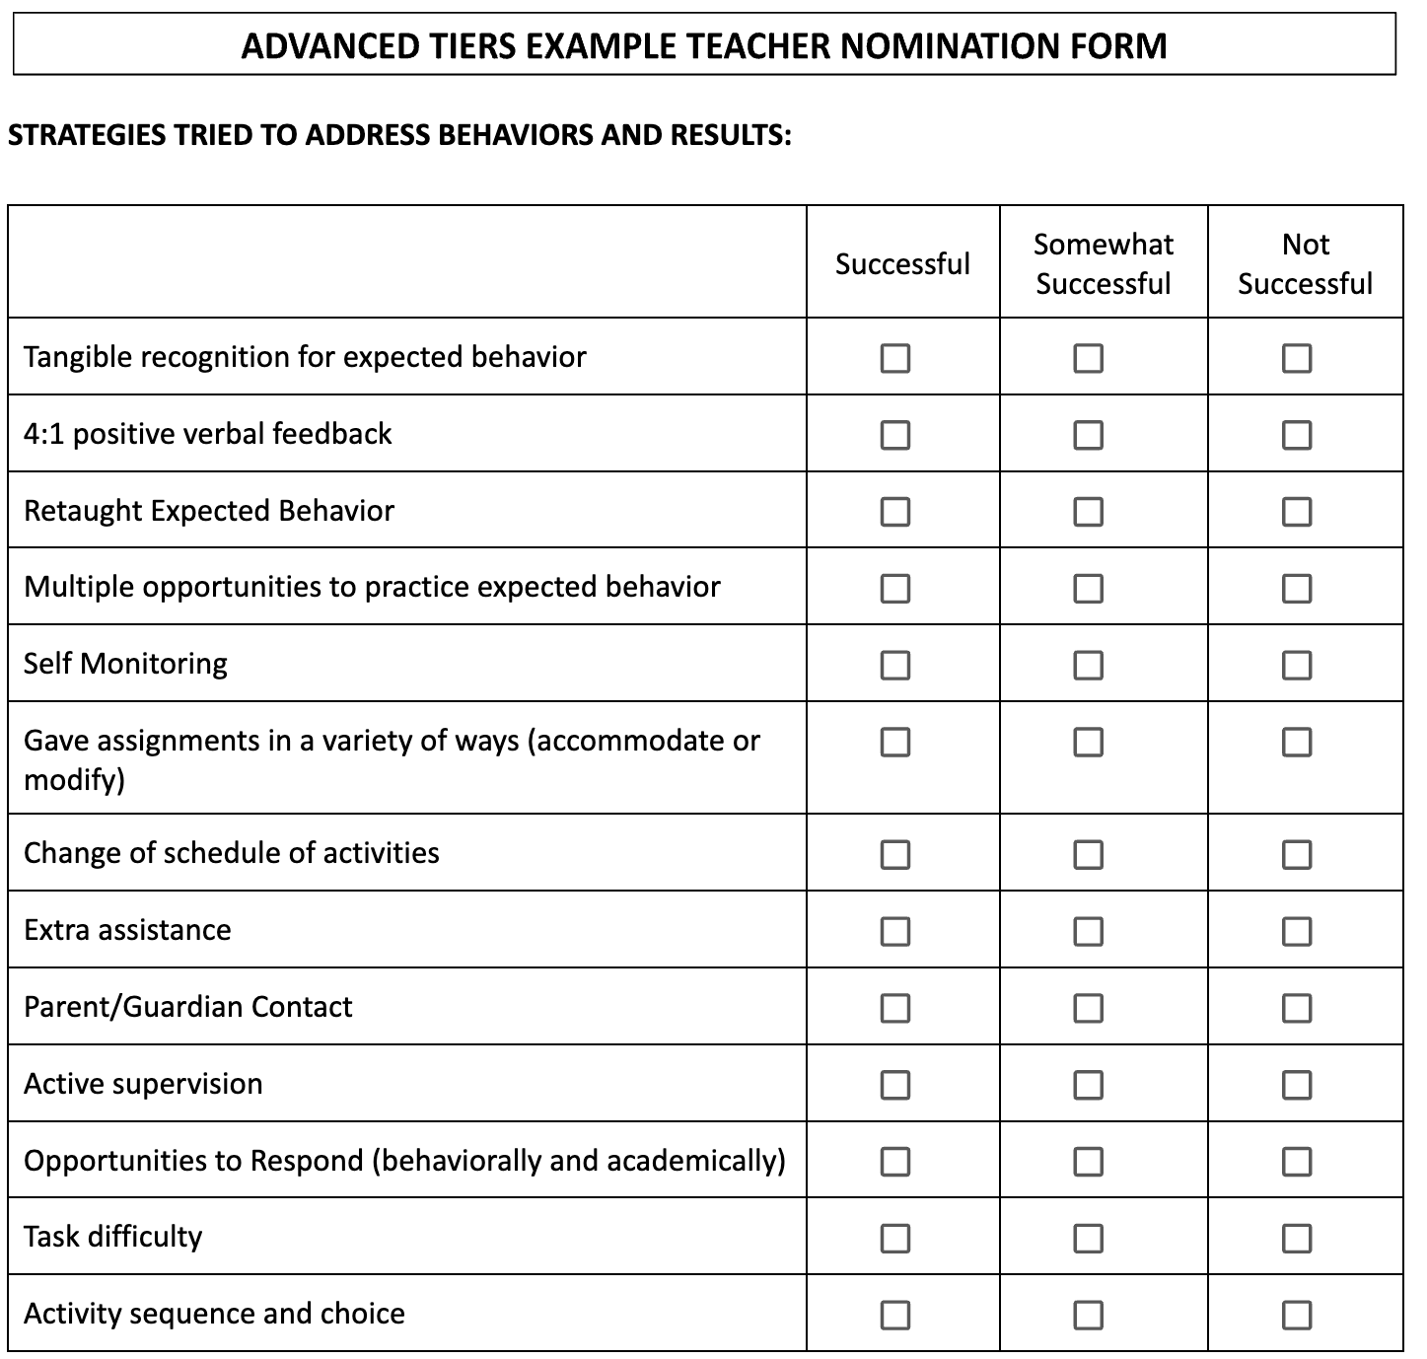
Advanced Tiers Teacher Nomination Form Example
Notes:
And the 4th area shown here is “Strategies Tried to Address Behavior and Results”

Slide 27
Pause & Reflect - Nomination
Does your team already have a nomination form and process?
If yes, can it be modified to include behavior?
If so, does information collected include:
    Identifying information about the student (gender, grade, IEP status)
    Academic performance data
    Information and data about problem behaviors
    Description of the problem
    Office discipline and/or classroom minor incidents
    List of strategies teacher has used to address the problem behaviors and how successful they have been
    Teacher perceptions regarding acquisition or performance deficits
If no,
Review the example provided
Create your own
Notes:
With your team, determine if there are existing nomination (request for assistance) processes that your school utilizes. If so, determine with your team whether to utilize (and potentially revise) your current nomination process or if a new process needs to be developed.
With your team, either modify an existing nomination process or develop a new nomination process. Remember the considerations of what to include on the form that was previously mentioned. Finally, with your team, determine the necessary logistics of the nomination process.
Additional Questions to Consider:
How do teachers access the nomination form?
Who do teachers contact for questions and/or to receive assistance with the nomination process?
Who receives the completed nomination form?
How is the team notified when there is a new nomination?

Slide 28
Universal Screener
Notes:
Another method to identify at-risk students is to use a screening instrument. There are a variety of tools available that allow teachers to identify and rate students.

Slide 29

Purpose of Universal Screening
One important goal is to “catch” students before academic and/or behavioral challenges become severe.
Notes:
Universal screening provides an opportunity for all children to be considered for risk factors against identified criteria.
Screening requires the use of a brief instrument that may include responses to short statements about emotional and/or behavioral characteristics of a student.
These instruments can be used to generate risk scores for all students in a grade level, building, or district.
Universal Screening shifts focus from a traditional “wait to fail” service delivery model toward proactively seeking out students who may be at risk of academic failure and/or behavioral difficulties that would potentially benefit from specific instruction or intervention (Glover & Albers, 2007).
This proactive approach minimizes impact of risk and/or may impede further development of more severe problems (Severson, Walker, Hope-Doolittle, & Kratochwill, 2007).

Slide 30

Standardized Screening –
Instrument Advantages
Notes:
There are many advantages to Universal Screening, including the following: it is fast, efficient, and respectful, and it includes all children and youth of interest.
Additionally, when using a universal screener, If we make an error, the error tends to identify students who are not at-risk. Universal Screening Informs schools about the entire student population and finally it helps find groups of students with common needs which facilitates resource mapping of services to be delivered.
Your team will need to decide if universal screening for behavior is right for you. Many schools in Missouri are now routinely using universal screening for literacy and seeing the benefits of this efficient and effective student identification process.

Slide 31
Standardized Screening Instrument
Possible Concerns
Schools tend to be a reactive rather than proactive with respect to behavior.
Concern about profiling/stigmatizing.
Fear of costs and potential to identify large number of at-risk students, thereby a need for additional support.
Notes:
“An effective comprehensive screening program requires a long-term investment of time, money, and personnel resources. Although the initial investment may be substantial, long-term benefits may include an overall decrease in costly special education referrals and grade retentions. Challenges of the 21st century require a systems approach to early intervention and prevention services informed by valid and reliable data collection. Universal screening programs are essential to ensuring that the children who need services earliest get just that.” (Henderson & Strain, 2009, p. 4)
Some Universal Screening Concerns
Behavior is viewed as purposeful rather than environmental.
Impression that kids will “grow out of it.”
Schools don’t know how to respond to behavior with the same confidence they respond to academic concerns

Slide 32

Determination of Need for a Universal Screener
Notes:
In order to make an informed decision as to the best screening instrument to utilize in your setting, teams must first identify the need or target area to be screened. Determination if need can come from multiple sources of data (e.g., stakeholder interviews, focus groups, reviews of existing data).
Some of the things to help you with Prioritizing based on your needs
High Rate of Suicide
Increase in Externalizing Behaviors - Examples - physical aggression
Adaptive Skills Concerns
Social Interactions Deficits- Examples- conflict management etc..
Increase in Internalizing Behaviors Examples

Slide 33
Optional: Universal Screening
Screener | Population | Feasibility/Usability | Informant/ Child Characteristics | Time | Psychometric Evidence
1.
2.
3.
4.
5.
Notes:
Trainer Notes: This slide is animated.
Once the area of greatest need has been determined, a potential list of screening instruments can be identified and evaluated against these considerations (Glover & Albers, 2007)
If your team is considering using a screening instrument, spend some time discussing the dimensions of screening with your team to prepare for review of potential instruments. You can use Evaluating Universal Screeners handout as an organizing tool to review and determine which screeners best meet the needs of your building.
(each arrow will appear on a Click)
• Population <CLICK> – relevance to your school’s population characteristics (e.g., age, demographics, characteristics); ideally the instrument has been validated and normed in a population similar to your population.
• Feasibility and usability <CLICK> - must be practical to administer; cost of administration (e.g., money, time) should not outweigh the benefits; stakeholders should view the tool as acceptable and relevant.
• Informant and child characteristics <CLICK> - balance of informants (student self-report, teacher report, family report) to increase reliability of screening results.
• Time <CLICK> – consider the amount of time required to administer as well as manage and analyze data; consider the amount of time and personnel required to train staff in instrument administration.
• Psychometric evidence <CLICK> – evidence exists for the reliability and validity of the instrument.

Slide 34
Commonly Used Behavioral / Emotional
Screening Instruments
Social, Academic, and Emotional Behavior Risk Screener (SAEBRS)
Strengths and Difficulties Questionnaire (SDQ)
Behavioral and Emotional Screening (BESS)
Student Risk Screening Scale - Internalizing and Externalizing (SRSS)
Mental Health, Social Emotional, and Behavioral Screening and Evaluation Compendium provides a comparison of no cost and at cost screeners.
Notes:
Universal screening that is based on valid and reliable instruments, allows for the identification of barriers to learning (e.g., internalizing behaviors, social relationships, externalizing behaviors) that are aligned to important academic and behavioral student outcomes (Eklund, Kilgus, von der Embse, Beardmore, & Tanner, 2017).
The SAEBRS, SDQ, BESS and SRSS are 4 of the most frequently used behavioral/emotional screening instruments. Additionally, some companies now have behavioral/emotional screening prompts included in their suite of online screening applications. For more information, see the Screening Instruments At-a-Glance Handout.
Additional for cost and no cost screeners are included in Mental Health, Social Emotional, and Behavioral Screening and Evaluation Compendium. This document includes helpful information for selecting an appropriate screener for your school, including age, target student population, purpose, etc.
Finally, an additional resource that teams may want to review is the Mental Health, Social Emotional, and Behavioral Screening and Evaluation Compendium (2nd ed.) developed by the Ohio Department of Education, Miami University’s Center for School-Based Mental Health Programs and the Ohio Mental Health Network for School Success. This compendium provides a succinct overview and comparison of both free and for cost screening tools.

Slide 35
Pause & Reflect: What systems need to be in place?
Use the Universal Screening Systems Considerations Handout to Assess systems needs for implementing universal screeners
Purpose and Policy for Screening
Procedures for Screening
Availability of Supports
Notes:
If your team is considering using a Universal Screening instrument, it is important to know there are numerous systems components that your team will need to consider, establish and maintained to conduct universal screening in a manner that is efficient, effective and ethical. Use the Universal Screening Considerations handout, (adapted from Mucott, 2008), to assess existing systems and needs for implementing universal screeners. This handout will help you to assess and plan for:
Documented Purpose and Policy -
* who approves a decision to begin screening,
* developing and communicating a clear purpose to all partners,
* policy/procedures for non-behavioral screening guides
* development of behavioral screening,
* family notification and engagement
* aligns with child-find,
* point of contact at building is assigned.
Clearly Defined Procedures –
* timeline for administration,
* inclusion of all students in screening process
* procedures for training all staff involved
Availability of Supports –
* includes documentation of all resources available for screening
* a team exists that includes students, their families and classroom teachers

Slide 36
Pause & Reflect – Universal Screening
What are common social emotional deficits that you are seeing across your setting?
What screening do we currently do at our school (i.e., academic, behavioral)?
Are we ready to add universal screening for behavior at this time?
If yes…
  Use the Screening Instruments At-a-Glance handout and the Mental Health, Social Emotional, and Behavioral Screening and Evaluation Compendium document to explore promising universal screeners for behavior
  Use the Evaluating Universal Screeners handout to select a screener that fits your context
  Use the Universal Screening Systems Considerations handout to identify systems that need to be put in place of modified
Notes:
With your team, determine whether or not your team wants to include universal screening at this time or wait to develop and implement at another time. If your team decides to wait, determine when you will revisit this decision.
If your team decides to move forward, use the Universal Screening Considerations adapted from Muscott (2008) see handout #6 to develop your implementation plan.

Slide 37
Next Steps
Create a process for using Existing School Data for student identification.
Decide which additional student identification process to develop and sustain, either Nomination or Universal Screening.
Update your action plan using the Advanced Tiers Developmental Checklist & Action Plan template.
Use the Advanced Tiers Artifacts Rubric to assess the quality of the resources your team develops.
Use the results of the PBIS Self-Assessment Survey (SAS) to gain perspective from all staff, and results from the PBIS Tiered Fidelity Inventory (TFI) to gain perspective from your building leadership team.
Notes:
During this lesson, you learned the importance of building a comprehensive system to Identify students who may need additional support.
How will your SW-PBS Leadership Team engage staff in discussing the importance and impact of identifying students who need additional support early and through multiple systems (Nomination, Existing School Data, Universal Screener)?

Slide 38
References
Albers, C. A., Glover, T. A., & Kratochwill, T. R. (2007). Introduction to the special issue: How can universal screening enhance educational and mental health outcomes?. Journal of School Psychology, 45(2), 113-116.
Anderson, C. M., & Scott, T. M. (2009). Implementing function-based support within schoolwide positive behavior support. In Handbook of positive behavior support (pp. 705-728). Springer US.
Crone, D.A., Hawken, L. S. & Horner, R. H. (2010). Responding to problem behavior in schools the behavior education program (2nd ed.). New York: The Guilford Press.
Elliott, S. N., Huai, N., & Roach, A. T. (2007). Universal and early screening for educational difficulties: Current and future approaches. Journal of School Psychology, 45(2), 137-161.
Henderson, J., & Strain, P. (2009). Screening for social emotional concerns: Considerations in the selection of instruments. Technical Assistance on Social Emotional Intervention. Retrieved from http://www.challengingbehavior.org/do/resources/documents/roadmap_1.pdf
Horner, R. H., Sugai, G. M., & Anderson, C. M. (2010). Examining the evidence base for school-wide positive behavior support. Focus on Exceptional Children, 42(8), 1-14.
Notes:
Here are some of the references that informed this lesson.

Slide 39
References Continued
McIntosh, K., Mercer, S. H., Hume, A. E., Frank, J. L., Turri, M. G., & Mathews, S. (2013). Factors related to sustained implementation of school-wide positive behavior support. Exceptional Children, 79, 293-311.
Noltemeyer, A., Dimick, A., & Smith-Millma, M. (Undated) Mental Health, Socioemotional, And Behavioral Screening And Evaluation Compendium. Miami University.
O’Connell, M. E., Boat, T., & Warner, K. E. (2009). Committee on the prevention of mental disorders and substance abuse among children, youth, and young adults: Research advances and promising interventions. Preventing mental, emotional, and behavioral disorders among young people: Progress and possibilities.
Walker, B., Cheney, D., Stage, S., Blum, C., & Horner, R. H. (2005). Schoolwide Screening and Positive Behavior Supports Identifying and Supporting Students at Risk for School Failure. Journal of Positive Behavior Interventions, 7(4), 194-204.
Walker, H. M., Horner, R. H., Sugai, G., Bullis, M., Sprague, J. R., Bricker, D., & Kaufman, M. J. (1996). Integrated approaches to preventing antisocial behavior patterns among school-age children and youth. Journal of Emotional and Behavioral Disorders, 4, 194-209.
Walker, H. M., & Gresham, F. M. (Eds.). (2014). Handbook of evidence-based practices for emotional and behavioral disorders. New York, NY: Guilford Press.

Slide 40


Contact Information
Check Out MO SW-PBS on Social Media:
Facilitator Contact Information:
pbismissouri.org
List HERE
facebook.com/moswpbs
instagram.com/moswpbs/

